Slide 1
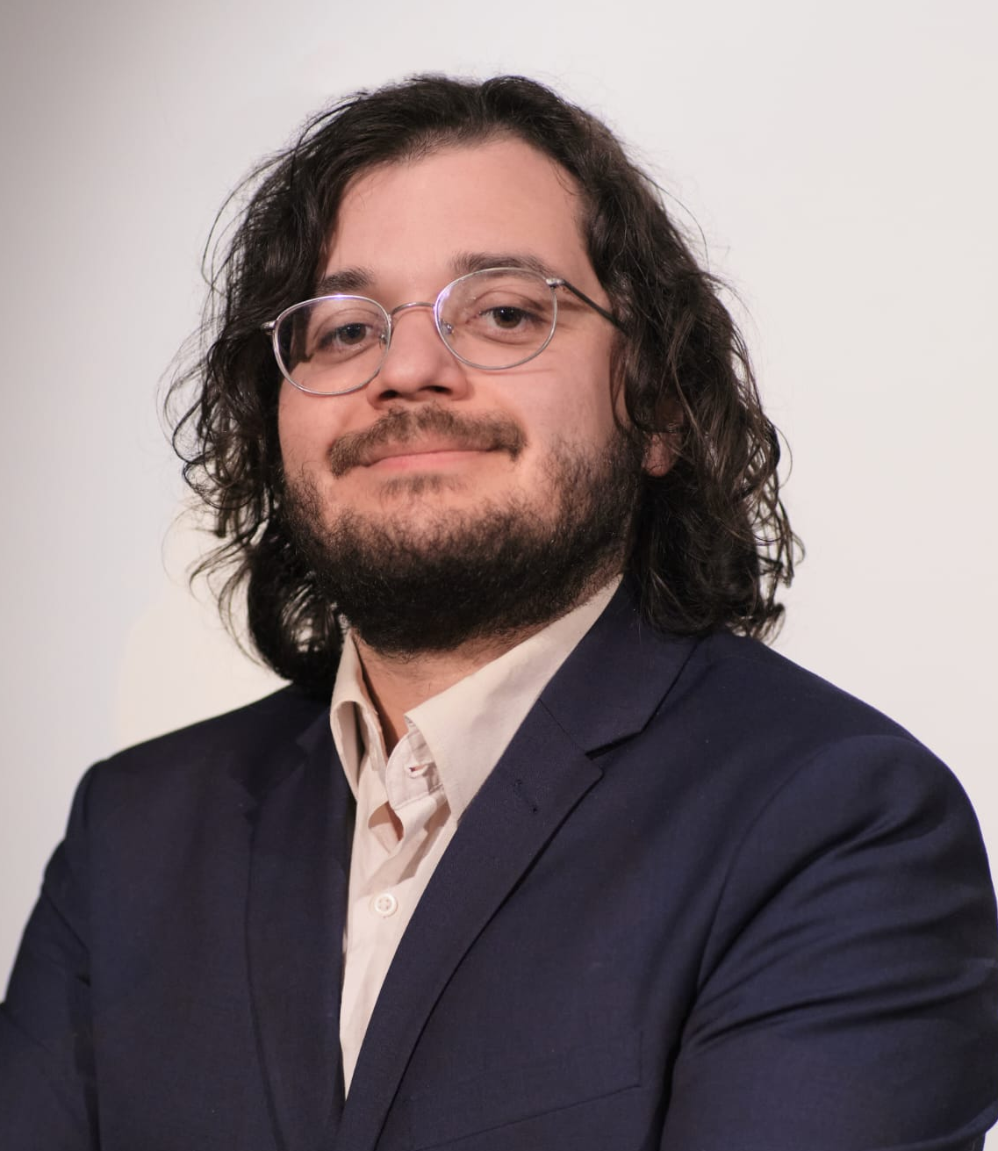
Juan Aponte
Entwicklungsingenieur
Email: juanaponterojas01@gmail.com
Tel: +49 1590 6402645
Anschrift: Spinnertraße 35, 38114 Braunschweig
Geburtstag: 22.11.1994, Bogota – Kolumbien LinkedIn: linkedin.com/in/juan-aponte-736a79126
Kurzprofil
Mechanical engineer with a Master's degree and strong expertise in CFD simulation, thermal systems, and battery modeling. Proficient in Python programming and experienced with OpenFOAM, ANSYS Fluent, and Modelica for simulating and optimizing thermal management solutions. Hands-on experimental validation skills and a proven ability to develop automation scripts and tools for simulation data analysis, aligning with the requirements of a CFD simulation engineer for thermal systems.
Berufserfahrung
Seit 02/2026
Selbstständige Weiterbildung in Machine Learning, KI-Agenten und eigenständige Projektarbeit in Batteriesystemen.
Projekt: Physikinformierter, LSTM-basierter digitaler Zwilling zur Schätzung des Batterieladezustands. Weitere Informationen auf GitHub und HuggingFace zu finden.
Masterand bei TLK-Thermo GmbH im Bereich Modellierung, Simulation und Optimierung
[work_descriptions:Masterand bei TLK-Thermo GmbH]
Praktikant und Werkstudent bei TLK-Thermo GmbH im Bereich Programmierung
[work_descriptions:Praktikant TLK-Thermo]
Wissenschaftliche Hilfskraft an Versuchsanlagen zu adaptiven Dichtungen in Turbomaschinen, TU Braunschweig (IFAS Institut)
[work_descriptions:Wissenschaftliche Hilfskraft IFAS]
04/2024 – 11/2024 Braunschweig
10/2023 – 03/2024 Braunschweig
10/2022 – 04/2023 Braunschweig
Seite 1 von 2

Slide 2
Bildungsweg
10/2020 – 11/2024 Braunschweig
Master in Maschinenbau mit Vertiefungspunkt Energie- und Verfahrenstechnik, TU Braunschweig
• Thermodynamics of Mixtures • Methods of Process Modelling and Optimization • Numerical Methods of Differential Equations • Modelling of Thermal Systems using Modelica • Student Research Project: Implementation of new back-plate measurement technology for carbon floating ring seals • Master's Thesis: Optimal control of a charging process for a battery system • Dinámica de fluidos computacional (CFD) • Termodinámica técnica
Bachelor Maschinenbau, Universidad Nacional de Colombia
• Thermodynamics of Mixtures • Methods of Process Modelling and Optimization • Numerical Methods of Differential Equations • Modelling of Thermal Systems using Modelica • Student Research Project: Implementation of new back-plate measurement technology for carbon floating ring seals • Master's Thesis: Optimal control of a charging process for a battery system • Dinámica de fluidos computacional (CFD) • Termodinámica técnica
01/2013 – 07/2019 Kolumbien
Weiterbildung
PyTorch for Deep Learning Bootcamp, ZTM Academy
Ein praxisorientierter Kurs zu Deep Learning mit PyTorch, einschließlich Modellaufbau, Training und Durchführung in reale Anwendungen.
Relevante Projekte
1. Optimal control of a charging process for a battery system Developed an optimal control approach for battery charging using Modelica and CasADi, achieving fast and safe charging while respecting temperature constraints. 2. Development of an Incompressible Flow Solver to Study Simple Phenomena Developed a compact high-order incompressible flow solver using compact finite differences and validated against the Backward Face Step benchmark.
Kentnisse
Technical: CFD, Thermal Simulation, Mechanical Design, Finite Element Analysis, Turbomachinery, Battery Modeling, Optimal Control, Machine Learning, Fluid Dynamics, Thermodynamics, Renewable Energy Technologies, Experiments Software: Python, PyTorch, Modelica, CasADi, MATLAB, Autodesk Inventor, Qt (PyQt6), Sphinx, Hugging Face Language: Spanish, English, German, Portuguese Soft: Presentation, Teamwork
Sonstige Leistungen
06/2019 – 10/2020, Usingen : Kultureller Austausch in Deutschland als Au-Pair
Seite 2 von 2

